Slide 1
Challenges of industrial policy to enhance competitiveness

Slide 2
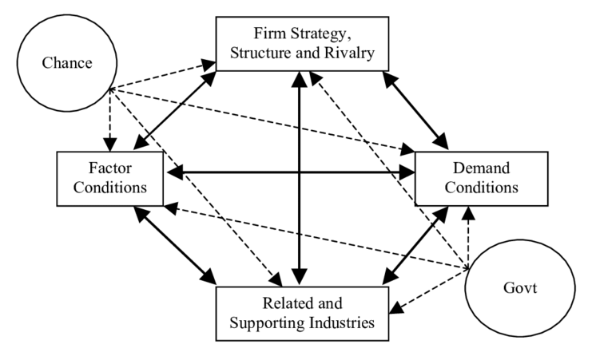

Slide 3
INSERTION TRAJECTORY INTO GLOBALIZATION
STRATEGIC-ORGANIC
COMPETITIVENESS
SOCIOECONOMIC SPACE
INDUSTRIAL DYNAMICS
THE FIRM
Dynamics of Continuous Evolutionary Adaptation

Slide 4
Dynamics of competitions in globalization
SOCIOECONOMIC SYSTEM
MACROECONOMIC LEVEL
MESOECONOMIC LEVEL
MICROECONOMIC – INDUSTRIAL LEVEL
THE FIRM
Cross-spatial – Cross-industrial – Inter-firm competitions, centered around the firm

Slide 5
Socioeconomic system
Socioeconomic space
Competitiveness
Industry
Industrial Policy
Firm

